Slide 1
Germany 1805-1919
https://www.youtube.com/watch?v=tq91I3TnWu4
What were the preconditions to Germany signing the Treaty of Versailles?

Slide 2
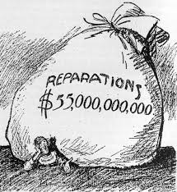
The fall of democratic government (Weimar)
Following WW1, German officials believed the ‘Big Three’ wouldn’t give them such harsh terms in the Treaty of Versailles if they had a democratic government. Therefore, the Weimar Republic was created.
The Nazi’s used the Great Depression and negative economic climate in Germany to gain popularity.
The Nazi Party gained votes in the Reichstag (government/parliament).
On 30th January 1933, President Hindenburg invited Hitler to become Chancellor.
Source 3

Slide 3
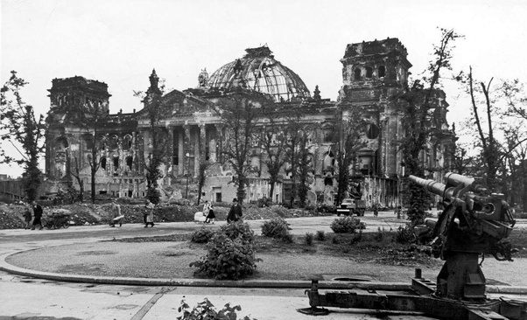
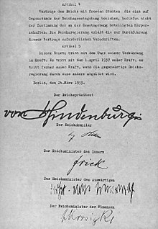
Consolidating Nazi Power
A month after Hitler became Chancellor, the Reichstag was severely damaged by fire.
The Nazi’s used this to stir fears of a Communist uprising.
Hitler persuaded President Hindenburg to issue a Decree for the Protection of People and State (The Reichstag Fire Decree) which abolished freedom of the press, speech and assembly.
The Nazi’s used this decree to restrict other political party campaigning.
March 1933 Reichstag elections, Nazi’s won.
23 March 1933 Enabling Act gave Hitler dictatorial powers.
Source 4

Slide 4
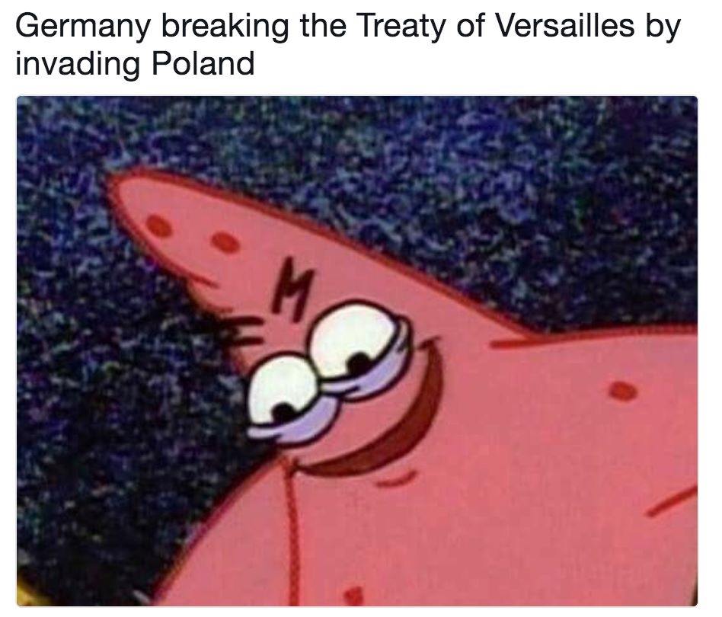
The Second World War begins…1939

Slide 5
Quick facts!
Polish Catholic midwife Stanisława Leszczyńska delivered 3,000 babies at the Auschwitz concentration camp during the Holocaust in occupied Poland.

Slide 6
Quick facts!
In World War II, British soldiers got a ration of three sheets of toilet paper a day. Americans got 22.

Slide 7
Quick facts!
Only 20% of the males born in the Soviet Union in 1923 survived the war.

Slide 8
Pop Question!
Who was Time Magazine’s Man of the Year in 1938?

Slide 9
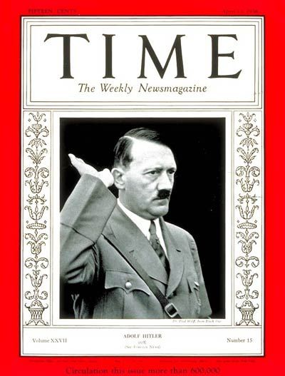

Slide 10
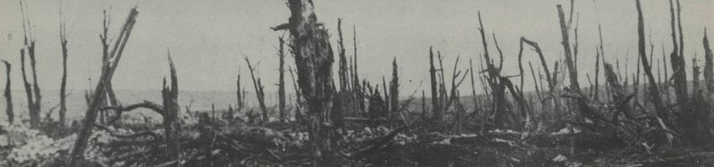
World War I

Slide 11
Nationalism-Devotion and loyalty to one’s country
Bosnia and Herzegovina demanded their independence from the Austro-Hungarian Empire
There was a competition in Europe for land, resources, and power. This competition led many countries to strengthen their armed forces (military)

Slide 12
Alliance-an agreement between countries.
Triple Alliance-Italy, Germany and Austria-Hungary
Triple Entente-France, Great Britain, and Russia

Slide 13
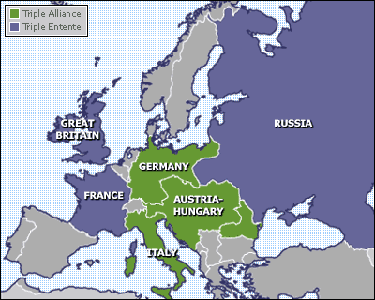
European Alliances Prior To WWI (1914)

Slide 14
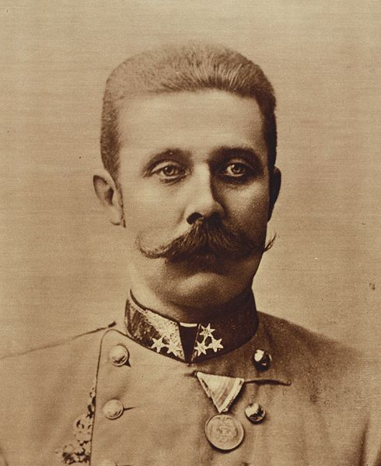
The Spark for War
Franz Ferdinand is the heir to the throne of Austria-Hungary

Slide 15
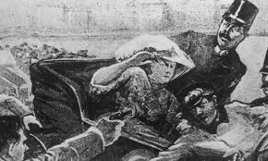
Assassination of Franz Ferdinand
The Archduke is assassinated by a Serbian on June 28, 1914.

Slide 16
New Alliances Form
Austria-Hungary declares war on Serbia after assassination.
Serbia turns to Russia for help and this forms new alliances in Europe.
Central Powers-Austria-Hungary and Germany
Allied Powers-Serbia, Russia, France and Great Britain

Slide 17
On the Battlefield
Germany sends troops into Belgium and France. The Allies stop the Germans just outside of Paris
Russia attacks Germany from the East, hoping to force Germany to fight on two sides of Europe and limiting their resources, which would hopefully end the war quickly.

Slide 18
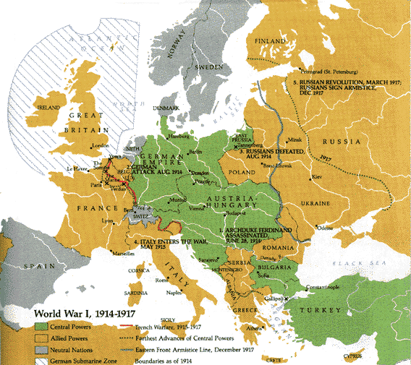

Slide 19
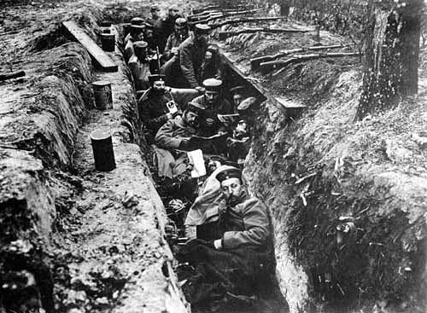
Trench Warfare
Trench Warfare-A style of fighting in which each side fights from deep trenches, or ditches, dug into the ground.

Slide 20
New Weapons
Machine Guns
Poison Gas
Tanks-Introduced by British
At Sea:
Britain used it’s Navy to block supplies from getting to Germany
Germany-used U-Boats (submarines) to try to and sink ships bringing supplies to Britain.

Slide 21
The End of the War
In 1917 America enters the war after repeated attacks on American ships by German U Boats
America’s help to the Allies gave them a fresh advantage.
Russia pulls out of the war soon after America enters
In the fall of 1918 the Central Powers surrender.

Slide 22
Treaty of Versailles
US and President Woodrow Wilson called for a just peace-fair not harsh or causing anger in the losing countries.
Other Allied leaders wanted to punish Germany for their actions.
The Treaty of Versailles was the final peace settlement officially ending WWI

Slide 23
Treaty of Versailles
Under the Treaty Germany had to:
Accept blame for starting the war
Slash the size of it’s army
Give up their overseas colonies
Pay Billions of Dollars for the damages caused by the war

